Slide 1
Query Optimization & Validation Using AI
An AI-Assisted Web Platform for Live SQL Validation, Schema-Aware Analysis and Query Optimization
Dissertation • S1-26_CSIWZG628T
Shruti Pal | BITS ID: 2022WB86845
MTech Computing Systems and Infrastructure – WIPRO (WIMS) • Research Area: Artificial Intelligence
Supervisor: Akash Kesharwani Additional Examiner: Akhilesh Singh
Birla Institute of Technology & Science, Pilani

Slide 2
Agenda
0
1
Broad Area of Work
6
Safety & Security
2
Background & Problem
7
Scope of Work
3
Objectives
8
Plan of Work
4
Solution & Architecture
9
Technology Stack
5
Key Features
10
Literature References
Query Optimization & Validation Using AI | Shruti Pal (2022WB86845)
1

Slide 3
1. Broad Area of Work
1
▸ Artificial Intelligence applied to database tooling — AI-assisted validation and optimization of SQL queries.
▸ A secure web platform: connect a database, write any SQL, get live validation plus an optimized equivalent query with an explanation.
▸ Core principle — user SQL and AI-generated SQL are NEVER executed.
  – Live SQL validation (deterministic, multi-dialect via SQLGlot)
  – Schema-aware analysis against the real database metadata
  – AI optimization: less data fetched, faster response, index recommendations
  – Secure cloud deployment on AWS with Cognito authentication
Query Optimization & Validation Using AI | Shruti Pal (2022WB86845)
2

Slide 4
2. Background & Problem Statement
2
▸ SQL is the primary language for relational databases, but writing correct, efficient queries is error-prone.
▸ Common issues: non-existent columns, syntax errors, unnecessary full scans (SELECT *).
▸ Traditional tools catch problems only AFTER execution — wasting resources and risking production for DML.
▸ In the employing organization, inefficient queries directly affect performance, cost and SLA compliance.
▸ LLMs can now understand, correct and rewrite SQL in context-aware ways.
▸ Combining LLM + deterministic parsing (SQLGlot) + live schema introspection enables safe, grounded assistance.
Query Optimization & Validation Using AI | Shruti Pal (2022WB86845)
3

Slide 5
3. Objectives
3
▸ Validate any SQL statement type (SELECT, INSERT, UPDATE, DELETE, DDL) live as the user types.
▸ Deterministic, multi-dialect syntax validation using SQLGlot — without executing the query.
▸ Schema-aware validation using the database's tables, columns, types, keys and relationships.
▸ AI layer to correct invalid queries and explain errors in simple language.
▸ Generate optimized, equivalent queries and recommend indexes.
▸ Guarantee safety: never execute user or AI-generated SQL.
▸ Secure portal (Amazon Cognito) with an AI provider fallback chain.
▸ Deploy on AWS and evaluate accuracy, optimization quality and time saved.
Query Optimization & Validation Using AI | Shruti Pal (2022WB86845)
4

Slide 6
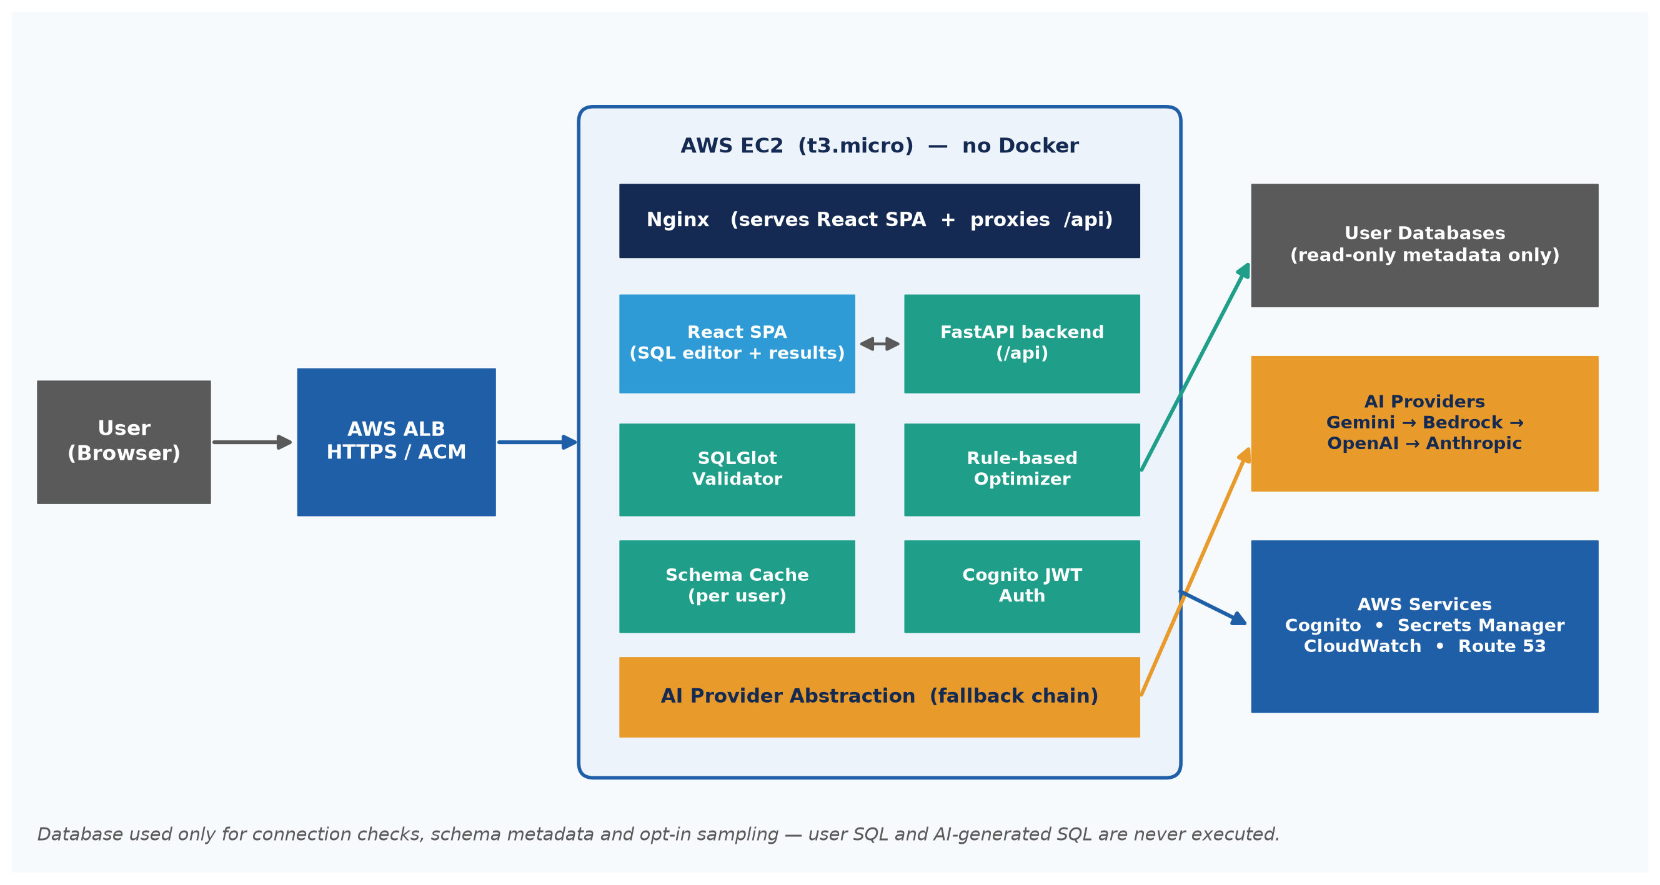
4. Solution & Architecture
4
Query Optimization & Validation Using AI | Shruti Pal (2022WB86845)
5

Slide 7
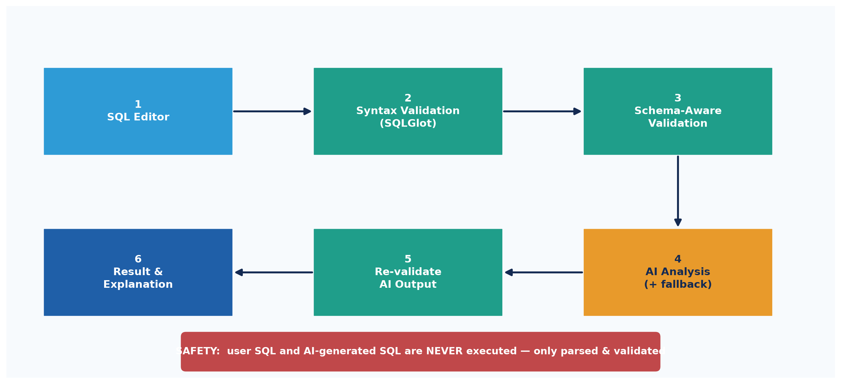
5. How a Query Is Processed (Data Flow)
5
Query Optimization & Validation Using AI | Shruti Pal (2022WB86845)
6

Slide 8
6. Key Features
6
Live Validation
Schema-Aware
AI Correction
Syntax errors with line/column highlighting as you type
Detect invalid table / column references
Fix queries + explain in plain language
Optimization
Index Advice
Multi-Dialect
Remove SELECT *, index-friendly filters, better joins
Recommend indexes & flag anti-patterns (estimates)
PostgreSQL, MySQL, SQL Server, SQLite, Oracle
Query Optimization & Validation Using AI | Shruti Pal (2022WB86845)
7

Slide 9
7. Safety & Security
7
▸ No query execution — neither user nor AI SQL is ever run against the database.
▸ DB connection used ONLY for connection checks, schema metadata and opt-in sampling.
▸ Database credentials never sent to any AI provider and never logged.
▸ AI provider keys in AWS Secrets Manager; Bedrock via EC2 IAM role (no static key).
▸ Authentication via Amazon Cognito: sign-up, email verification, login, forgot/reset password.
▸ Per-user data isolation using the Cognito 'sub' identifier.
Query Optimization & Validation Using AI | Shruti Pal (2022WB86845)
8

Slide 10
8. Scope of Work
8
In Scope
Out of Scope
✓ Live, multi-dialect SQL syntax validation
✓ Schema-aware checking against the real database
✓ AI-assisted correction, optimization & index advice
✓ Re-validate every AI suggestion before showing it
✓ Cognito-secured portal deployed on AWS
✗ Executing user or AI-generated SQL
✗ Automatic schema changes / self-healing
✗ EXPLAIN-based query-plan tuning (MVP)
✗ Live connections for non-PostgreSQL dialects (MVP)
Query Optimization & Validation Using AI | Shruti Pal (2022WB86845)
9

Slide 11
9. Plan of Work
9
Phase | Duration | Work to be done
Project Outline | Week 1 – 2 | Study existing approaches, literature review, prepare outline
Design & Development | Week 3 – 8 | Build validator, schema analysis, AI optimization + fallback, Cognito, AWS
Testing | Week 9 – 11 | Validate accuracy & optimization, safety checks, conclusions
Project Review | Week 12 – 13 | Submit to Supervisor & Additional Examiner for review
Submission | Week 14 – 15 | Final review and submission of the report
Query Optimization & Validation Using AI | Shruti Pal (2022WB86845)
10

Slide 12
Technology Stack
10
Backend
Python
FastAPI
SQLGlot
Frontend
React
TypeScript
Vite
Nginx
Databases
PostgreSQL
MySQL
SQL Server
SQLite
Oracle
AI Providers
Gemini
Bedrock
OpenAI
Anthropic
AWS
EC2
ALB
Route 53
ACM
Cognito
Secrets Mgr
CloudWatch
Tooling
Git
GitHub
VS Code
Query Optimization & Validation Using AI | Shruti Pal (2022WB86845)
11

Slide 13
Literature References
11
[1] SQLGlot — SQL Parser, Transpiler and Optimizer (official docs).
[2] C. J. Date. SQL and Relational Theory. O'Reilly Media.
[3] M. Winand. SQL Performance Explained.
[4] T. Brown et al. Language Models are Few-Shot Learners. NeurIPS 2020.
[5] Google. Gemini API Documentation.
[6] Amazon Web Services. Amazon Bedrock User Guide.
[7] AWS. Amazon Cognito & Amazon EC2 User Guides.
[8] PostgreSQL Global Development Group. Using EXPLAIN & Query Planning.
Query Optimization & Validation Using AI | Shruti Pal (2022WB86845)
12

Slide 14
Thank You
Questions & Discussion
Shruti Pal • 2022WB86845

